Slide 1

Planetary Rovers: Intelligent Agents CW
lk383

Slide 2
The Rovers and The world
Map Representation
Coordinate system relative to the base as rovers always start at the base.
Do modular arithmetic to keep coordinates within the bounds of the map
When moving to a world location, calculate the best offset to move which requires the least amount of energy
Implemented 3 Types of Rovers
Basic Rover - Searches the map for resources and Collects them
Scanner Rovers - Searches the map for resources, can’t pick them up
Collector Rovers - Collects the resources found by Scanner

Slide 3
Basic Rover
Available Actions: Move, Scan, Collect and Deposit
Goal/Objective: Find and Deposit all resources
Rover Stats
Collect = Number of Resources in a pile
Speed, Scan = remaining stat points evenly distributed
Move around the map along an optimal search pattern, Scanning after each move action.
Depending on the objects found do different actions
Base: Deposit current load
Resource: Move to Resource -> Collect -> Move to base -> Deposit -> Return

Slide 4
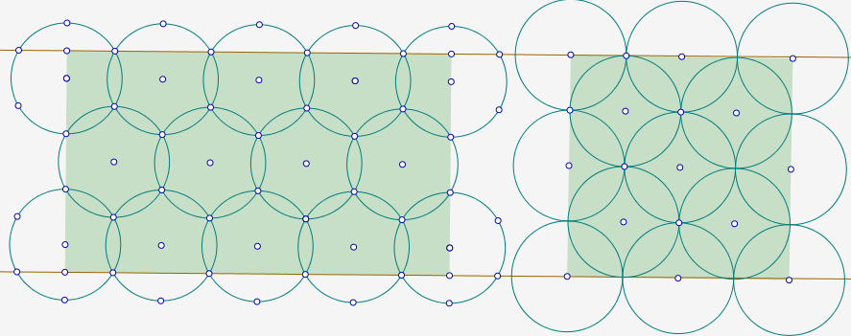
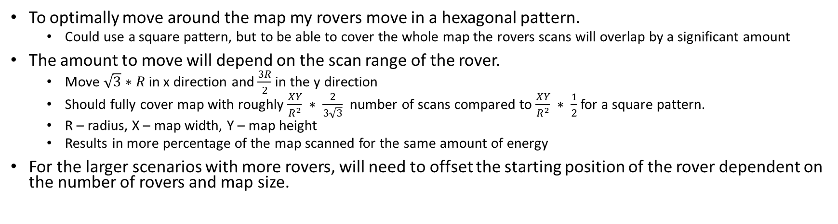


Search Pattern
To optimally move around the map my rovers move in a hexagonal pattern.
Could use a square pattern, but to be able to cover the whole map the rovers scans will overlap by a significant amount
The amount to move will depend on the scan range of the rover.
Move $\sqrt{3}∗R$ in x direction and $\frac{3R}{2}$ in the y direction
Should fully cover map with roughly $\frac{XY}{R^{2}} ∗ \frac{2}{3\sqrt{3}}$ number of scans compared to $\frac{XY}{R^{2}} ∗ \frac{1}{2}$ for a square pattern.
R – radius, X – map width, Y – map height
Results in more percentage of the map scanned for the same amount of energy
For the larger scenarios with more rovers, will need to offset the starting position of the rover dependent on the number of rovers and map size.

Slide 5
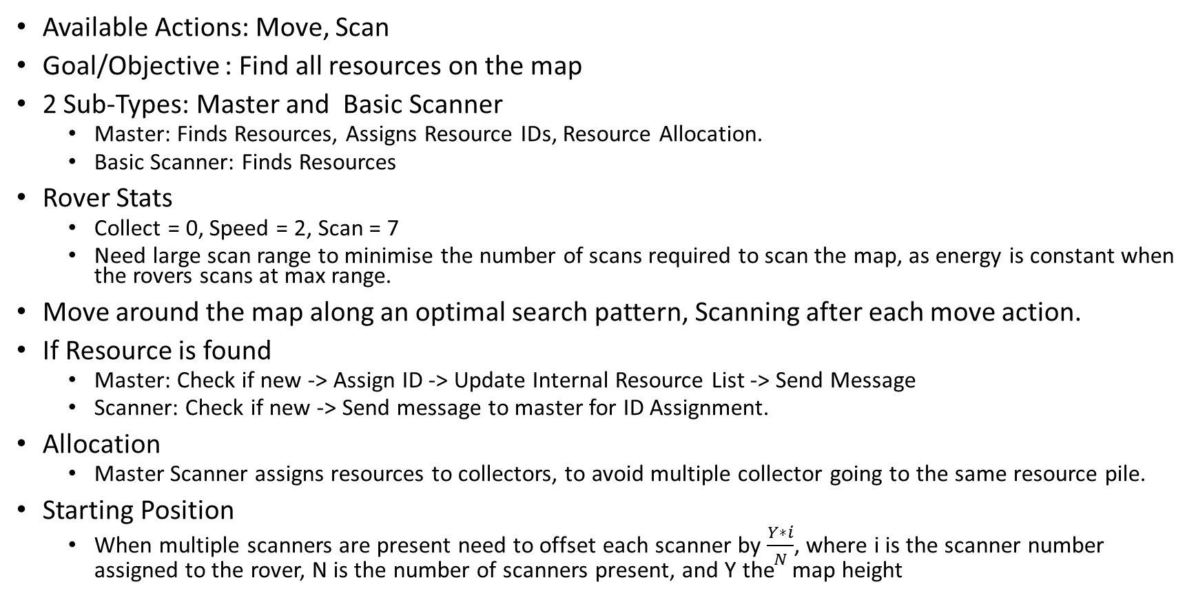
Scanner Rover
Available Actions: Move, Scan
Goal/Objective : Find all resources on the map
2 Sub-Types: Master and Basic Scanner
Master: Finds Resources, Assigns Resource IDs, Resource Allocation.
Basic Scanner: Finds Resources
Rover Stats
Collect = 0, Speed = 2, Scan = 7
Need large scan range to minimise the number of scans required to scan the map, as energy is constant when the rovers scans at max range.
Move around the map along an optimal search pattern, Scanning after each move action.
If Resource is found
Master: Check if new -> Assign ID -> Update Internal Resource List -> Send Message
Scanner: Check if new -> Send message to master for ID Assignment.
Allocation
Master Scanner assigns resources to collectors, to avoid multiple collector going to the same resource pile.
Starting Position
When multiple scanners are present need to offset each scanner by $\frac{Y∗i}{N}$, where i is the scanner number assigned to the rover, N is the number of scanners present, and Y the map height

Slide 6
Collector Rover
Available Actions: Move, Scan, Collect and Deposit
Goal/Objective: Collect and Deposit the most resources
Rover Stats
Collect = Number or Factor of Resources in a pile, Scan = 1, Speed = Remaining stat points
Calculates the best resource to collect.
Calculates the energy required to pick up and deposit a maximum load of each resource in the resource list
Sort them by increasing energy cost
Send allocation request to master
Receive Allocation from master -> Collect allocated resource.
When collecting resources run a scan with small radius to check that resource is still present.
Use small radius to minimise the energy used.
If Resource no longer present, send message to master stating that resource is now empty
If the Resource is still present after filling the rover up. The rover will send an un-allocation request to the master rover to free up that resource for another collector

Slide 7
Messaging
Master/Slave messaging for task allocation and resource updating
Master rover stores the most up-to-date version of the resource list, assign resource IDs and allocations based on this list.
Messages send objects that have been JSONed
3 Types of Messages
Resource Updates :
Sends a Resource Object, containing Location, Type, isEmpty and Assigned Rover
Used add/update resources to rovers internal Resource Lists
Allocations and Allocation Requests:
Send an Allocation Object, containing a List of Resources the rover can collect in order of cheapest energy, The rover ID of the rover that sent the Message, ID of the final allocated resource
Used by Master to Assign Rovers to Resources
Rover Type
Used to Identify the number of scanners in the scenario, Which can be used to define the movement offset the (slave) scanners should start out , to get a reasonable spread of scanners.

Slide 8
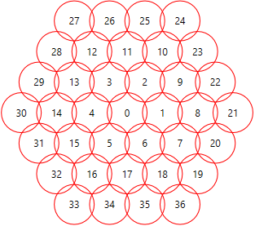
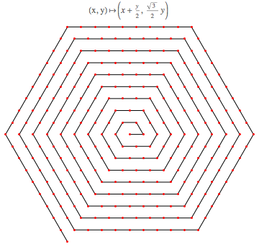
Further improvements I
Improved Search Pattern
Hexagonal Spiral Movement
Define the movement direction within the Hexagonal Pattern as a spiral
This will find the resources closest to the base first
Can better distribute the basic scanners around the map, as Hexagons Tesselate
Calculate the number of Scans each scanner can do, then start the i-th scanner at location of the final scan performed by scanner I -1

Slide 9
Further Improvements II
Refined Energy Calculation and Micro-Trips
Currently the rovers should only collect a resource if they can pick up resource until its full and then deposit them at the base, This doesn’t always calculate correctly and rovers will run out of energy when moving back to base while carrying resources
Micro-Trip – add functionality such that rover can pick up a number of resource less than the number it can carry from a pile, such that It can safely return with them.
Resource Auction/Bidding System
Make it such that the resources will be allocated to the rover that will take the least about of energy to collect it, compared to the current first come, first served method at the moment. This will minimise the total energy spent hence increasing the performance of each scenario
This would be a first price, sealed bid, one shot auction where the collectors bid is the energy required to collect a resource and the Master chooses the smallest.

